Slide 1


Department of BES-I
COURSE: Data Structures Using Python
COURSE CODE: 24SC1204
Name of the topic:
Quick Sort & Implementation
Session – 5

Slide 2



AIM OF THE SESSION
Quick sort Analysis Implementation
INSTRUCTIONAL OBJECTIVES
This Session is designed to:
Demonstrate The Divide and Conquer in Quick sort Function
Describe the Picking a pivot
List out the operations possible on the Partitioning.
Describe the Swapping Process
List out the advantages and applications of Quick sort
LEARNING OUTCOMES
At the end of this session, you should be able to:
Define Quick sort
Describe The Swapping process
Summarize definition, types and operations of quick sort and its applications

Slide 3
Quick Sort
INTRODUCTION
The quicksort algorithm starts by picking a pivot element and then subdivides the array. It then puts the smaller elements on the left side of the pivot and the larger ones on the right side. The partition of arrays continues until each array is left with a single element.
Divide: In Divide, first pick a pivot element. After that, partition or rearrange the array into two sub-arrays such that each element in the left sub-array is less than or equal to the pivot element and each element in the right sub-array is larger than the pivot element.
Conquer : Recursively, sort two subarrays with Quicksort.
Combine: Combine the already sorted array.

Slide 4
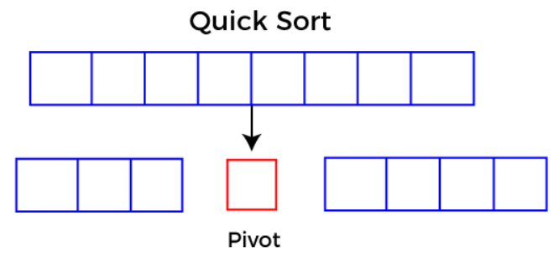
Quick Sort
INTRODUCTION CONT..
Quicksort picks an element as pivot, and then it partitions the given array around the picked pivot element. In quick sort, a large array is divided into two arrays in which one holds values that are smaller than the specified value (Pivot), and another array holds the values that are greater than the pivot.
After that, left and right sub-arrays are also partitioned using the same approach. It will continue until the single element remains in the sub-array.

Slide 5

Example of Quick sort
Working of Quick Sort Algorithm
Now, let's see the working of the Quicksort Algorithm.
To understand the working of quick sort, let's take an unsorted array. It will make the concept more clear and understandable.
Let the elements of array are -

Slide 6
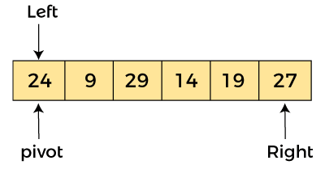
Quick sort Example Cont.…
In the given array, we consider the leftmost element as pivot. So, in this case, a[left] = 24, a[right] = 27
and a[pivot] = 24. Since, pivot is at left, so algorithm starts from right and move towards left.

Slide 7
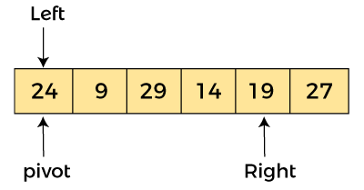
Quick sort Example (Cont..)
Now, a[pivot] < a[right], so algorithm moves forward one position towards left, i.e. -

Slide 8
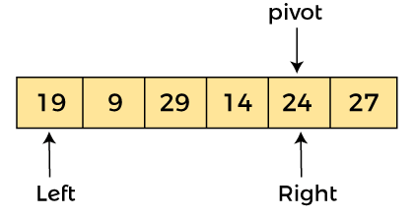
Quick sort Example (Cont..)
Now, a[left] = 24, a[right] = 19, and a[pivot] = 24.
Because, a[pivot] > a[right], so, algorithm will swap a[pivot] with a[right],
and pivot moves to right, as -

Slide 9
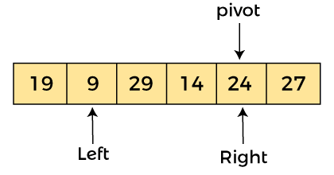
Now, a[left] = 19, a[right] = 24, and a[pivot] = 24. Since, pivot is at right, so algorithm starts from left and moves to right.
As a[pivot] > a[left], so algorithm moves one position to right as -

Slide 10
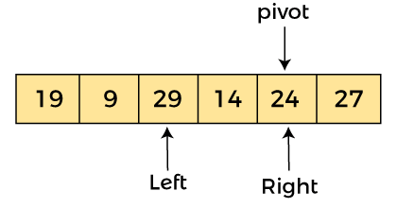
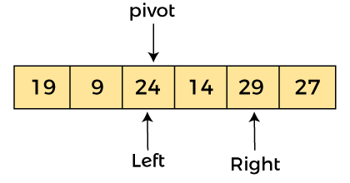
Now, a[left] = 9, a[right] = 24, and a[pivot] = 24. As a[pivot] > a[left], so algorithm moves one position to right as -
Now, a[left] = 29, a[right] = 24, and a[pivot] = 24. As a[pivot] < a[left], so, swap a[pivot] and a[left], now pivot is at left, i.e. -

Slide 11
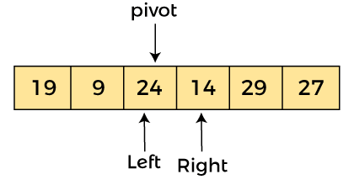
Since, pivot is at left, so algorithm starts from right, and move to left. Now, a[left] = 24, a[right] = 29, and a[pivot] = 24. As a[pivot] < a[right], so algorithm moves one position to left, as -

Slide 12
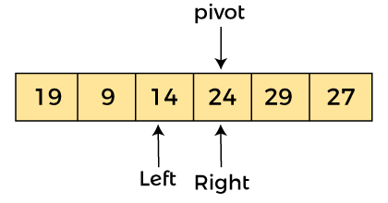
Now, a[pivot] = 24, a[left] = 24, and a[right] = 14. As a[pivot] > a[right], so, swap a[pivot] and a[right], now pivot is at right, i.e. -

Slide 13
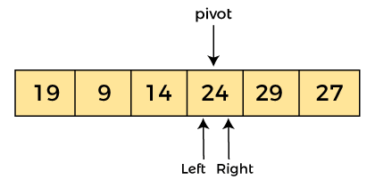
Now, a[pivot] = 24, a[left] = 14, and a[right] = 24. Pivot is at right, so the algorithm starts from left and move to right.

Slide 14
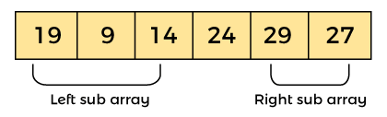
Now, a[pivot] = 24, a[left] = 24, and a[right] = 24. So, pivot, left and right are pointing the same element. It represents the termination of procedure.
Element 24, which is the pivot element is placed at its exact position.
Elements that are right side of element 24 are greater than it, and the elements that are left side of element 24 are smaller than it.

Slide 15

Now, in a similar manner, quick sort algorithm is separately applied to the left and right sub-arrays. After sorting gets done, the array will be -

Slide 16
Implementation of Quick sort in descending order
def quick_sort(arr, low, high):
if low < high:
# Find the pivot element such that elements greater than pivot are on the left
pivot_index = partition(arr, low, high)
# Recursively sort the elements before and after partition
quick_sort(arr, low, pivot_index - 1) # Left of pivot
quick_sort(arr, pivot_index + 1, high) # Right of pivot
def partition(arr, low, high):
# Choose the last element as the pivot
pivot = arr[high]
# Pointer for the smaller element
i = low - 1
# Traverse through the array and arrange elements
for j in range(low, high):
if arr[j] > pivot: # Compare with pivot for descending order
i += 1
arr[i], arr[j] = arr[j], arr[i] # Swap if greater than pivot

Slide 17
Implementation of Quick sort in Descending order
# Place the pivot element at the correct position
arr[i + 1], arr[high] = arr[high], arr[i + 1]
return i + 1
# Example usage
arr = [10, 7, 8, 9, 1, 5]
n = len(arr)
print("Original array:", arr)
quick_sort(arr, 0, n - 1)
print("Sorted array in descending order:", arr)
OUT PUT:
Original array: [10, 7, 8, 9, 1, 5]
Sorted array in descending order: [10, 9, 8, 7, 5, 1]
Time Complexity:
Best and Average Case: O(n log n) – This occurs when the pivot divides the array evenly.
Worst Case: O(n^2) – This happens when the pivot is the smallest or largest element, leading to unbalanced partitions.
Space Complexity:
O(log n) for the recursion stack space in the average case, but it can go up to O(n) in the worst case.

Slide 18
IMPORTANT FACTS RELATED TO THE SESSION
Advantages of a Quick sort
Quick sort has a fast average-case time complexity of O(nlogn), making it efficient for large datasets.
It is a simple and easy-to-implement algorithm that can be implemented in a few lines of code.
Quick sort can be easily parallelized, making it suitable for use on multicore and distributed systems.
It is an in-place sorting algorithm, which means that it does not require additional memory to store temporary variables or data structures.
Disadvantages of a Quick sort
Quick sort has a worst-case time complexity of O(n^2) if the pivot element is chosen poorly or the data is already sorted.
It is not a stable sorting algorithm, which means that it does not guarantee the relative order of equal elements in the sorted array.
Quick sort is not suitable for sorting large datasets that do not fit in memory, as it requires multiple passes over the data.

Slide 19
IMPORTANT FACTS RELATED TO THE SESSION
Applications/Characteristics of quick sort
Quick sort divides an array into two sections according to a pivot element, usually the last element in the array.
All elements smaller than the pivot are put in one partition, and all elements larger than the pivot are placed in the other, dividing the array into two partitions.
The algorithm repeats this procedure for each division until the array as a whole is sorted.
If the data is already ordered or the pivot element is not carefully chosen, quick sort has a worst-case time complexity of O(n2).

Slide 20
Time Complexity of Quick sort
Let us consider the following terminologies:
T(K): Time complexity of quicksort of K elements
P(K): Time complexity for finding the position of pivot among K elements.
Best Case:
The best case occurs when we select the pivot as the mean. So here
T(N) = 2 * T(N / 2) + N * constant
Now T(N/2) is also 2*T(N / 4) + N / 2 * constant. So,
T(N) = 2*(2*T(N / 4) + N / 2 * constant) + N * constant
= 4 * T(N / 4) + 2 * constant * N.
So, we can say that
T(N) = 2k * T(N / 2k) + k * constant * N
then, 2k = N
k = log2N
So T(N) = N * T(1) + N * log2N. Therefore, the time complexity is O(N * logN).--→ eq1

Slide 21
Time Complexity of Quick sort
Time Complexity Analysis:
Best Case: O(n log n)
  This occurs when the pivot divides the array into two nearly equal halves. Each recursive call works on a sub-array half the size of the previous call.
Average Case: O(n log n)
  On average, the pivot divides the array into two fairly balanced sub-arrays, leading to a logarithmic number of recursive calls, and each call processes n elements.
Worst Case: O(n²)
  This occurs when the pivot is the smallest or largest element in the array, leading to unbalanced partitions. For example, if the array is already sorted or nearly sorted and we consistently pick a bad pivot (e.g., the first or last element), the recursion will proceed in linear fashion, processing one element at a time.
Space Complexity:
  Best/Average Case: O(log n) for the recursion stack.
  Worst Case: O(n) when the recursion depth becomes linear due to unbalanced partitions.

Slide 22
Time Complexity of Quick sort
Example:
arr = [10, 7, 8, 9, 1, 5]
OUTPUT:
Best Case (Balanced Partitioning):
Pivot selection: Let’s assume the pivot is chosen randomly or it divides the array into nearly equal halves at each level of recursion.Example: For the array [10, 7, 8, 9, 1, 5], let's say the pivot is 7 in the first partitioning.
After partitioning, the array might look like this: [1, 5, 7, 9, 8, 10], with 7 in its correct position.Then, we sort the subarrays [1, 5] and [9, 8, 10] recursively.
The recursive calls break the problem down into sub-problems of size n/2 at each level, resulting in a logarithmic number of levels.

Slide 23
Time Complexity of Quick sort
Let’s walk through a simple example with an array [10, 7, 8, 9, 1, 5].
Initial Array: [10, 7, 8, 9, 1, 5]
  Choose pivot = 5 (last element).
  After partitioning, the array becomes: [1, 5, 8, 9, 7, 10]. Now the pivot 5 is placed in the correct position.
Left Sub-array [1]: It has only one element, so it’s already sorted.
Right Sub-array [8, 9, 7, 10]:
  Choose pivot = 10 (last element).
  After partitioning, the array becomes: [8, 9, 7, 10], with pivot 10 in its correct position.
Sub-arrays [8, 9, 7]:
  Choose pivot = 7.
  After partitioning, the array becomes: [7, 9, 8], with pivot 7 in its correct position.
Sub-arrays [9, 8]:
  Choose pivot = 8.
  After partitioning, the array becomes: [8, 9], with pivot 8 in its correct position.
At the end of the recursion, the array is sorted as [1, 5, 7, 8, 9, 10].

Slide 24
SELF-ASSESSMENT QUESTIONS
Which of the following sorting algorithms is the fastest?
a) Merge sort
b) Quick sort
c) Insertion sort
d) Shell sort
2. Which of the following methods is the most effective for picking the pivot element?
a) First element
b) Last element
c) Median of three partitioning
d) Random element

Slide 25
TERMINAL QUESTIONS
1. Describe About Quick sort?
2. Implementation of Quick sort ?
3. Analyze the time complexity of Quick sort?
4. Summarize working principle of quick sort?

Slide 26
REFERENCES FOR FURTHER LEARNING OF THE SESSION
Textbooks:
Mark Allen Weiss, Data Structures and Algorithm Analysis in C, 2010, Second Edition, Pearson Education.
Allen B. Downey, ”Think Python: How to Think Like a Computer Scientist’’, 2nd edition, Updated for Python 3, Shroff/O’Reilly Publishers, 2016 (http://greenteapress.com/wp/thinkpython/)
Data Structures and algorithms using python, 2011,Rance D, Necaise, himilton printing
ReferenceBooks:
Data Structures and Algorithm Analysis in PYTHON, 2010, Mark Allen Weiss, Second Edition, Pearson Education.
Data Structures and Algorithms, A.V.Aho, J.E.Hopcroft, and J.D.Ullman, Pearson Education, First Edition Reprint2003.
Advanced Guide to Python 3 Programming, John Hunt, 4th Edition, Springer Nature Switzerland AG 2019.
Python Basics: A Practice Introduction to Python 3, David Amos, Dan Bader, Joanna Jablonski, Fletcher Heisler, 4th edition, Real Python.
WebLinks:
https://docs.python.org/3/tutorial/datastructures.html
https://www.w3schools.com/dsa/dsa_intro.php
https://www.geeksforgeeks.org/python-data-structures/

Slide 27
THANK YOU
Team – Data Sructures

